Slide 1
Sentinel Forge AI-Powered Resilience for India’s MSME Sector
Hackfest 2k26
Protecting the Backbone of Industry 4.0 with Agentic Intelligence.
Team – Data Dynamos

Slide 2

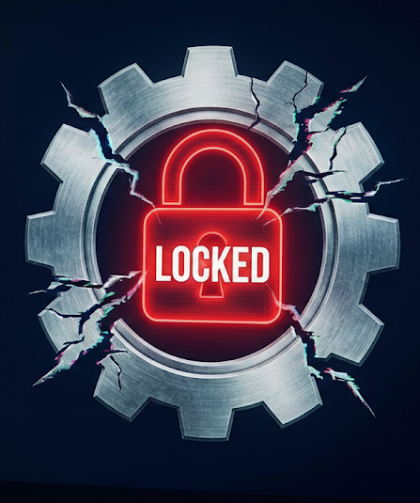
Problem Statement
The Threat Landscape
The MSME Vulnerability
Windows endpoints are constant targets for ransomware, stealthy fileless malware, and zero-day exploits.
Indian MSMEs (30% of GDP) are adopting "Smart Factory" tech but remain "soft targets" due to the high cost of enterprise security.
The Technical Failure
The Bottom Line
Traditional tools provide fragmented telemetry and high-latency analysis, failing to stop attacks before they cause physical manufacturing downtime.
A single breach doesn't just steal data; it stops the machines, leading to catastrophic financial loss.

Slide 3

Project Abstract: The SentinelForge Initiative
Our solution implements a Multi-Agent AI architecture that provides passive, real-time monitoring of Windows endpoints. By analyzing network patterns, system logs, and memory events, SentinelForge identifies and neutralizes threat including ransomware, fileless malware, and machine manipulation without the need for expensive, proprietary hardware.
SentinelForge is a potent, AI-driven cybersecurity ecosystem engineered specifically for the Micro, Small, and Medium Enterprises (MSMEs) of India. As these industries transition into Industry 4.0, they face an escalating surge of cyber-physical attacks that threaten the very heart of their manufacturing operations.
Key Impact: Strengthens industrial resilience, reduces operational downtime, and democratizes high-end cybersecurity for the 63 million MSMEs driving the Indian economy.

Slide 4

Objectives
Six AI Agents
Specialised models for Network, Memory, Logs, Web, Audit and System Health.
Agentic Manager
Real-time Dashboard
Live web UI for multiple Windows systems with secure login and audit trails.
Central coordinator to aggregate findings, prioritise alerts and enforce policies.
Live Windows Integration
Real-time collection from kernel, memory, ETW/logs and network stacks using researched packages.

Slide 5
Existing System
Latency:
Data aggregation and processing in traditional systems can introduce latency of minutes to hours, which is unacceptable for real-time threat detection on a single host in dynamic cybersecurity environments requiring immediate response.
Cost:
Enterprise SIEMs often entail licensing fees of hundreds of thousands to millions annually, a prohibitive barrier for individual users or educational settings.
Complexity:
Setup can take months and requires specialist teams for configuration and ongoing maintenance, a sharp contrast to the need for rapid deployment and ease of use in smaller environments.

Slide 6
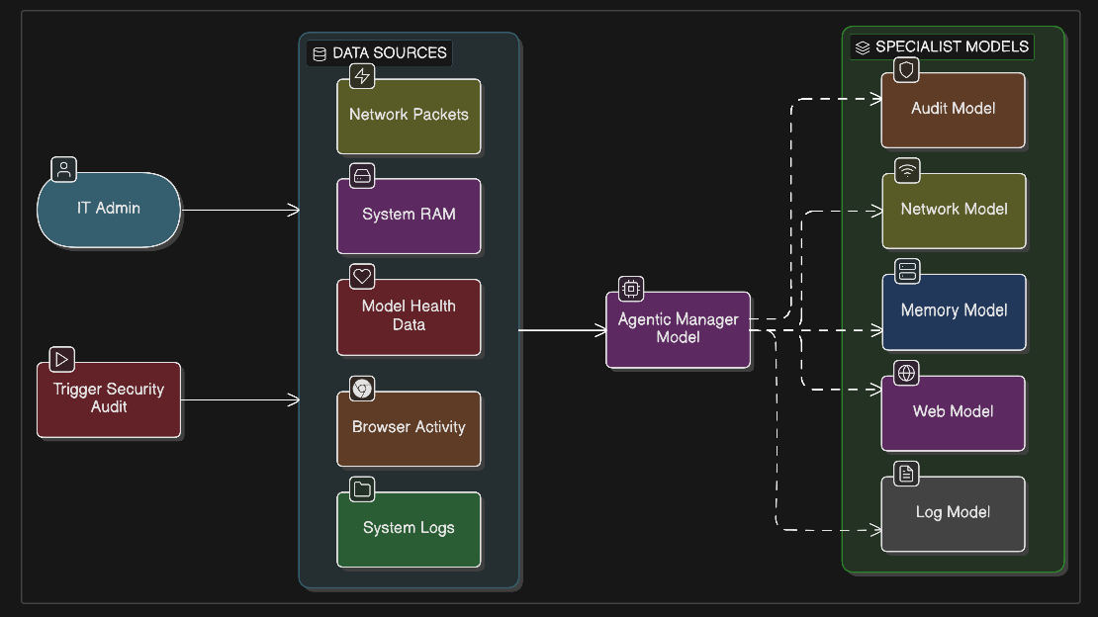
Flow Chart

Slide 7
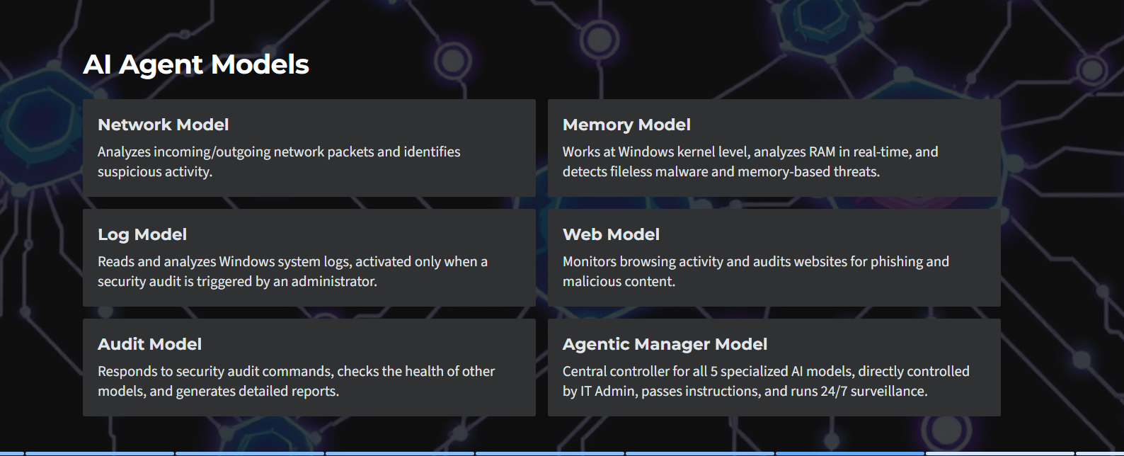
AI Agent Models

Slide 8
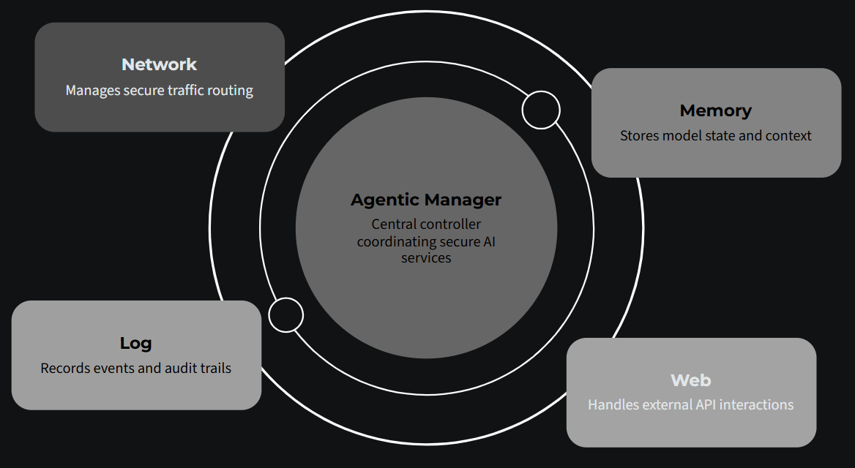
Architecture Diagram
Audit Model
Checks the health of other models, and generates detailed reports.

Slide 9
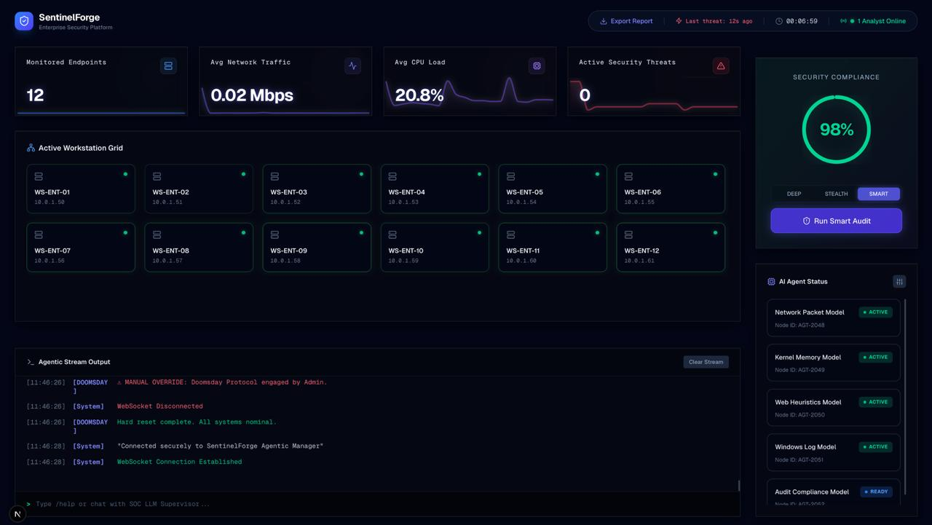
Output
Normal

Slide 10
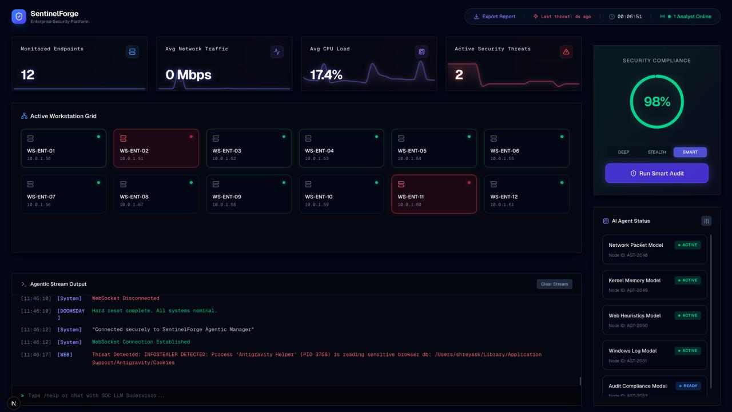
Output
Threat Detected

Slide 11

Thank You

